Slide 1


Reinforcement Learning
Ch. 8: Planning and Learning with Tabular Methods
Richard S. Sutton
MIT Press

Slide 2
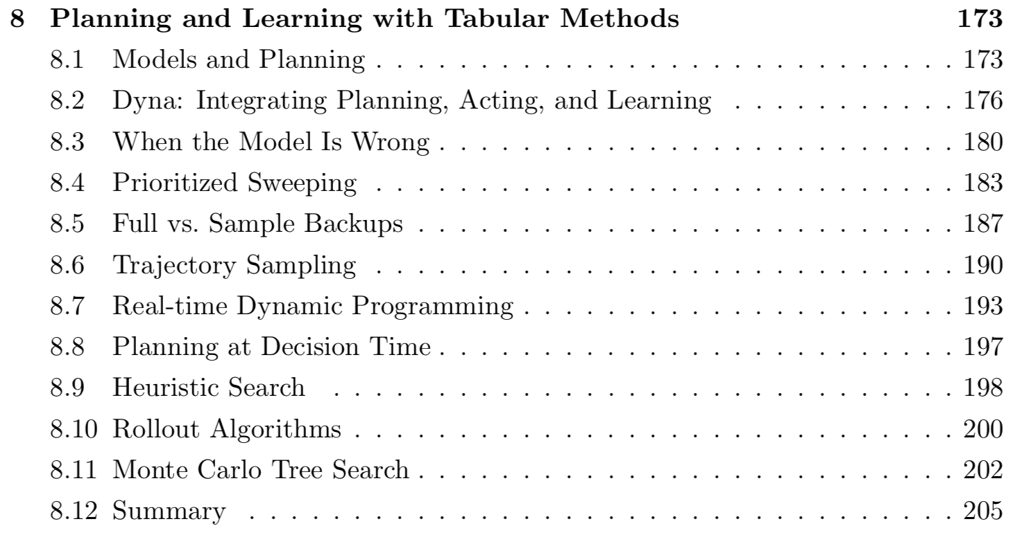
Ch. 8 Planning and Learning with Tabular Methods

Slide 3
Ch. 8 Planning and Learning with Tabular Methods
In this chapter,
Develop a unified view of ‘Planning’ (model-based. Ex. DP, HE) and ‘Learning’ (model-free. Ex. MC, TD).
The heart of both kinds of methods is the computation of value functions.
All the methods are based on looking ahead to future events,
Computing a backed-up value
Using it as an update target for an approximate value function.

Slide 4
8.1 Models and Planning
모델이란:
Anything that an agent can use to predict how env. will respond to its action
Given a state and an action, a model produces a prediction of the resultant next state and next reward.
- If model is stochastic, several possible state and reward. -
Distribution models: produce a description of all possibilities and their probabilities.
Sample models: produce just one of the possibilities, sampled according to the probabilities.
Model can be used to mimic or simulate experience.

Slide 5
8.1 Models and Planning
Planning
Takes a model as input and produces or improves a policy for interacting with the modeled environment
Two basic ideas of planning:
Computing value functions as a key intermediate step toward improving the policy
Compute their value functions by backup operations applied to simulated experience
Various planning methods fit this structure, with individual methods differing only in the kinds of updates they do, the order in which they do them, and in how long the backed-up information is retained.
Planning
Model
Policy

Slide 6
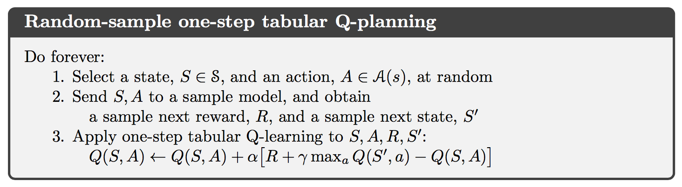
8.1 Models and Planning
The heart of both learning and planning methods is the estimation of value functions by backup operations.
Planning: uses simulated experience generated by a model.
Learning: uses real experience generated by the environment.
It means that many ideas and algorithms can be transferred between planning and learning.
Simple example of a planning method based on one-step tabular Q-learning.

Slide 7
8.1 Models and Planning
Second theme in this chapter is the benefits of planning in small, incremental steps.
This enables planning to be interrupted or redirected at any time with little wasted computation.

Slide 8
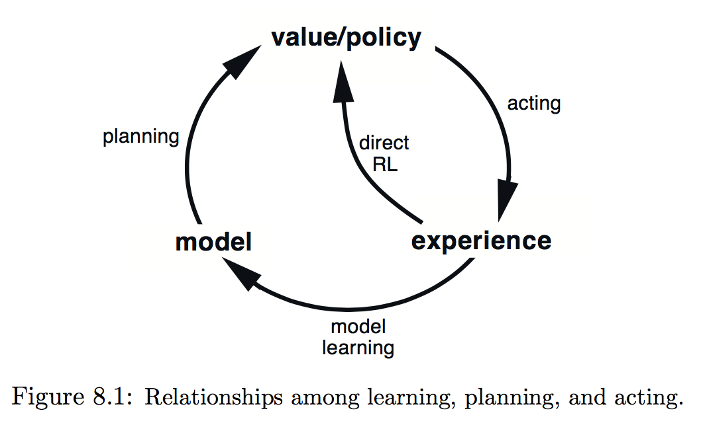
8.2 Dyna: Integrating Planning, Acting, and Learning
Dyna-Q:
Simple architecture integrating planning and learning
Two roles for real experience :
To improve the model (Model-learning / indirect RL)
To directly improve the value function and policy (direct RL)

Slide 9
8.2 Dyna: Integrating Planning, Acting, and Learning
Indirect method:
Make fuller use of a limited experience
Achieve a better policy with fewer environmental interactions.
Direct method:
Much simpler
Not affected by biases in the design of the model.

Slide 10
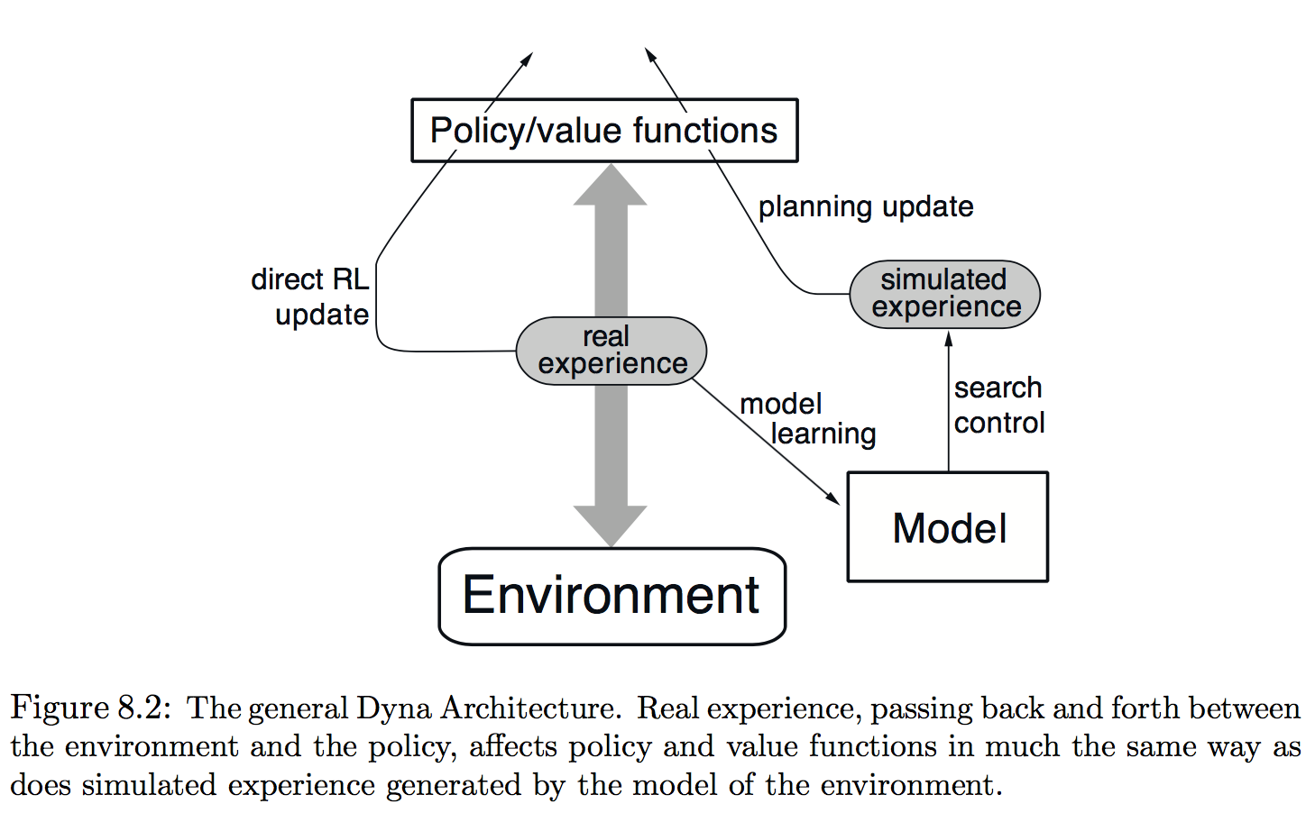
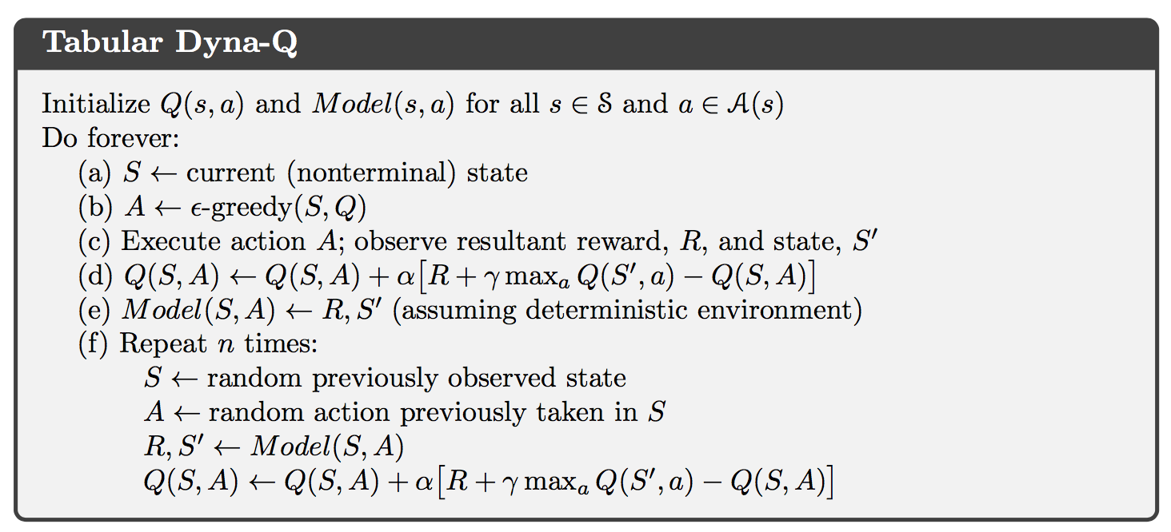
8.2 Dyna: Integrating Planning, Acting, and Learning

Slide 11
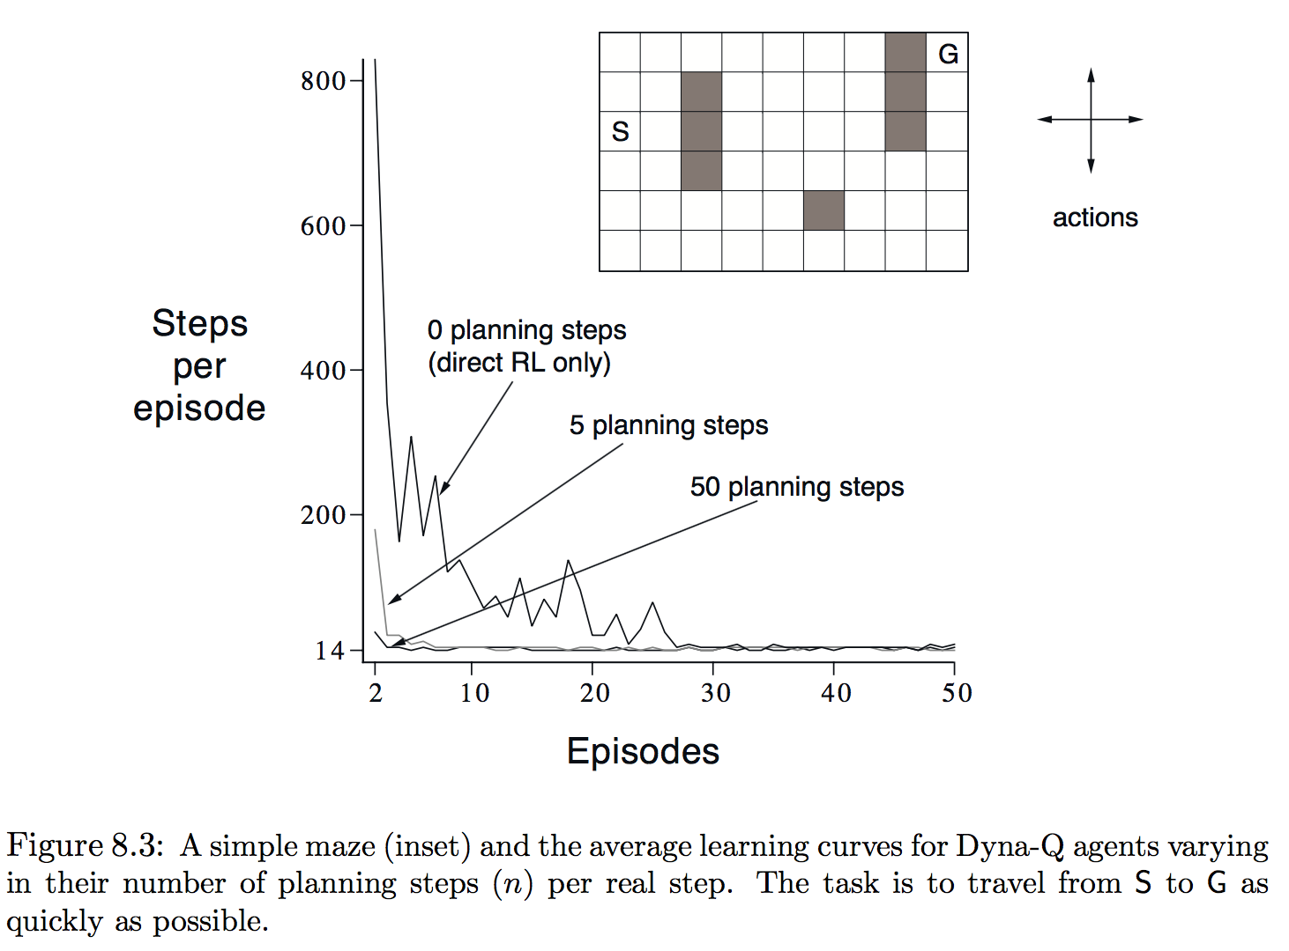
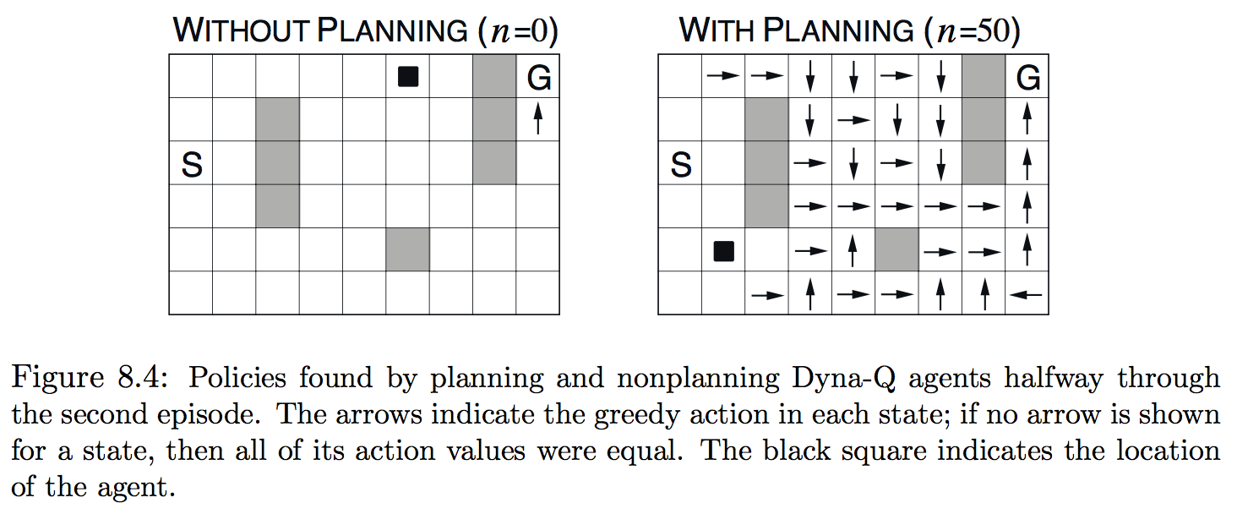
Ex. 8.1: Dyna Maze

Slide 12
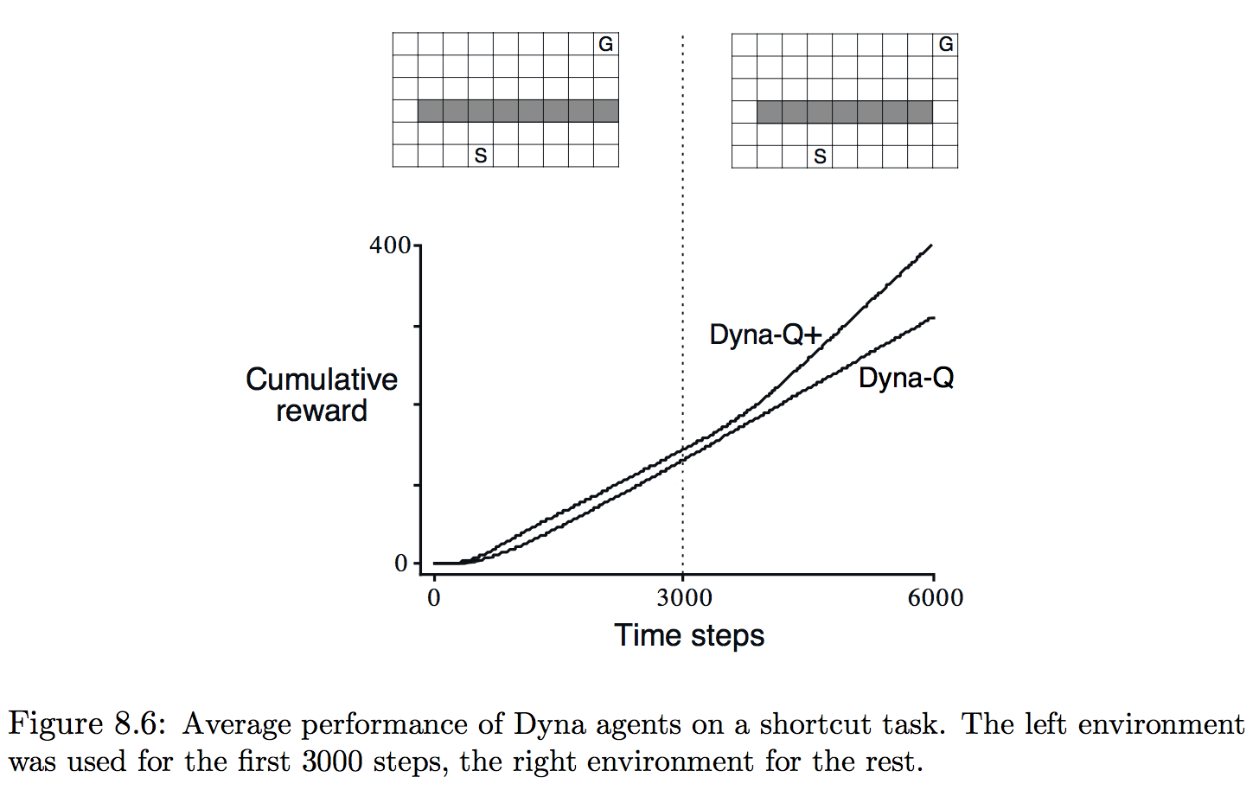
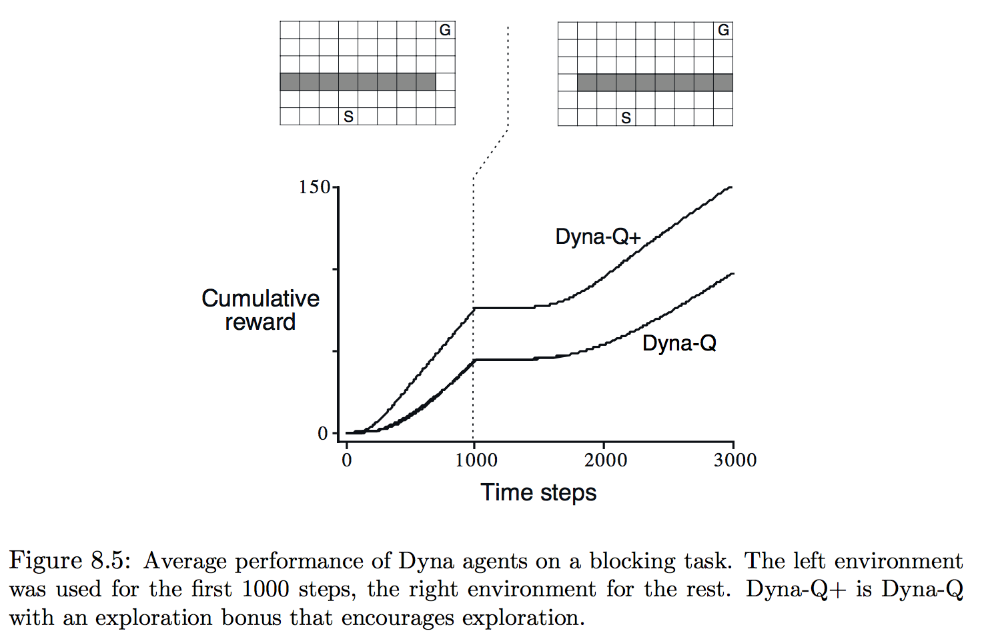
8.3 When the Model is Wrong
Models may be incorrect because the env. is stochastic and only a limited number of samples have been observed.
Or models was learned using function approximation that has generalized imperfectly.
Or simply because the env. Has changed and its new behavior has not yet been observed.
모델이 실제보다 높은 reward나 좋은 state transition을 예측하는 경우에 sub optimal에서 쉽게 빠져나옴.
반대의 경우는 Exploration이 많아야함.

Slide 13
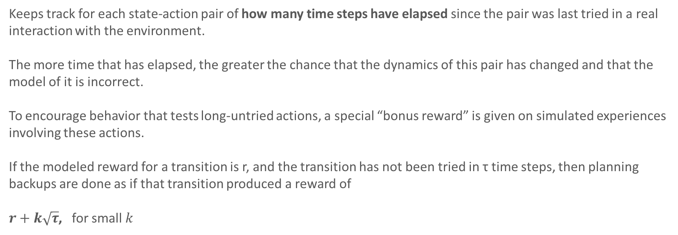
8.3 Dyna Q+
Keeps track for each state-action pair of how many time steps have elapsed since the pair was last tried in a real interaction with the environment.
The more time that has elapsed, the greater the chance that the dynamics of this pair has changed and that the model of it is incorrect.
To encourage behavior that tests long-untried actions, a special “bonus reward” is given on simulated experiences involving these actions.
If the modeled reward for a transition is r, and the transition has not been tried in τ time steps, then planning backups are done as if that transition produced a reward of
$r+k\sqrt{τ}$, for small $k$

Slide 14
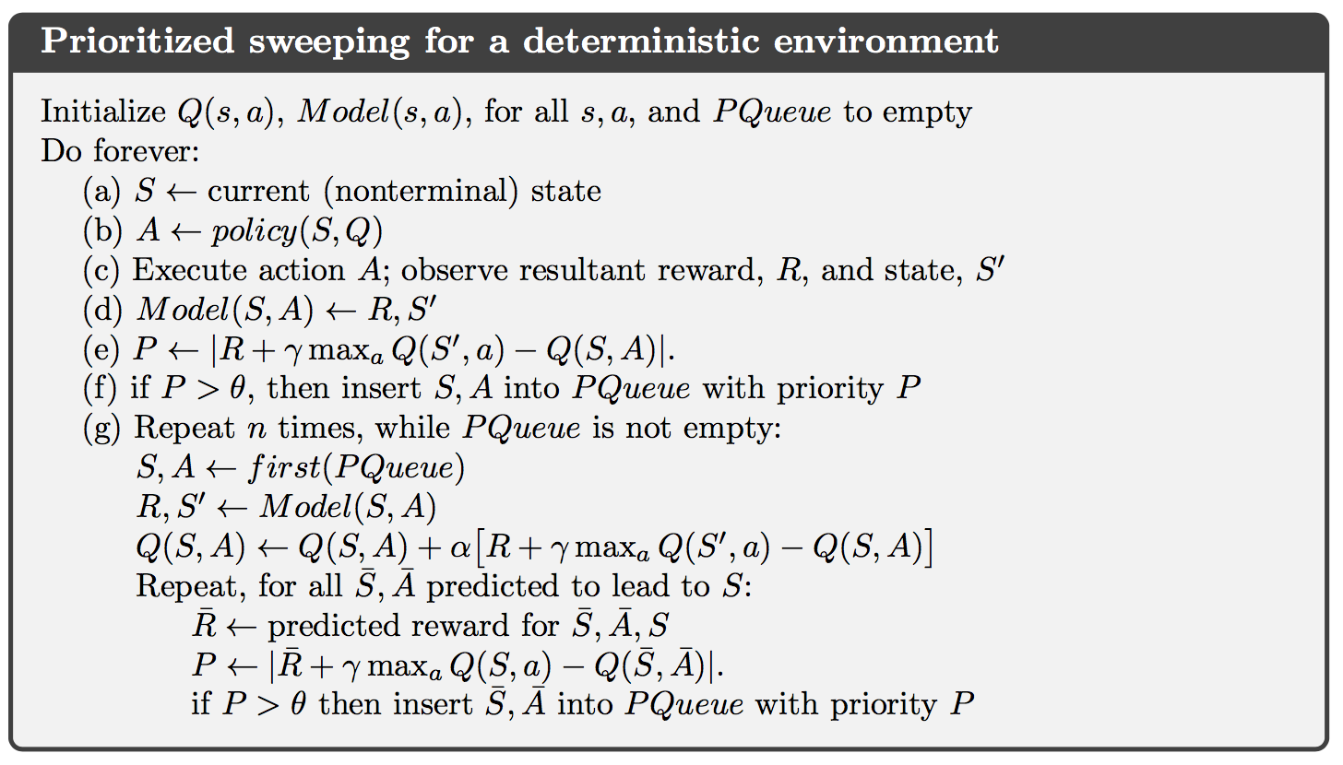
8.4 Prioritized Sweeping
Planning할 때, experience를 랜덤하게 선택(Dyna) 하는게 아니라 우선순위를 두고 선택.
우선순위: 예측한 reward와 실제와의 차이.

Slide 15
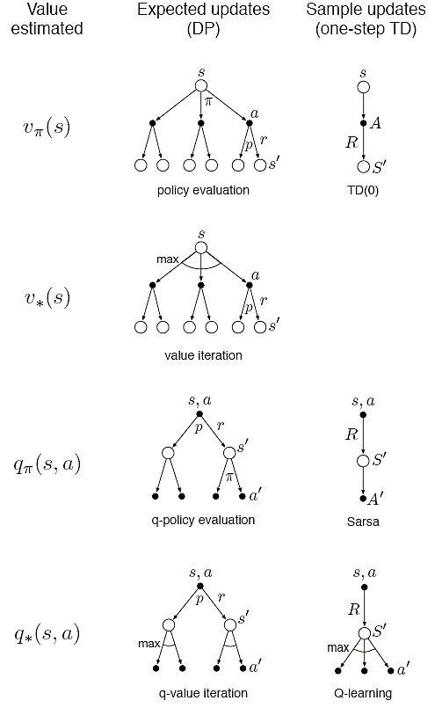




8.5 Expected vs. Sample Updates
Different kinds of value-function updates.
Three dimensions
1. State values (v) or action values (q)
2. Value for the optimal policy or for an arbitrary given policy.
3. Expected updates or sample updates.
Distribution model 이 없으면 Expected update는 불가능하지만
가능한 경우 Expected update가 선호된다.
Sampling error는 없다는 장점이 있지만 많은 computation 필요.
Dyna-Q
Notes:
Previous sections give some idea of combining of Learning and Planning.
In the rest of this chapter, we analyze some of the component ideas involved starting with the relative advantages of expected and sample updates

Slide 16
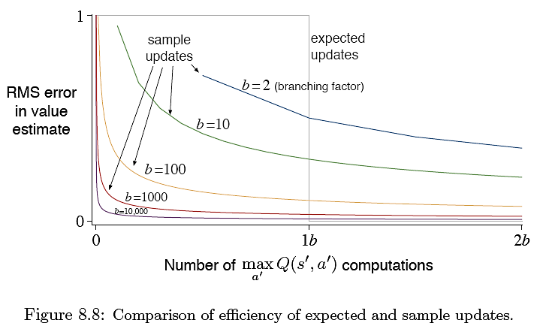
8.5 Expected vs. Sample Updates
Computation 시간이 충분치 않으면 항상 Sample update가 좋다.
- They at least make some improvement in the value estimate with fewer than b (branching factor) updates.
Notes:
Previous sections give some idea of combining of Learning and Planning.
In the rest of this chapter, we analyze some of the component ideas involved starting with the relative advantages of expected and sample updates

Slide 17
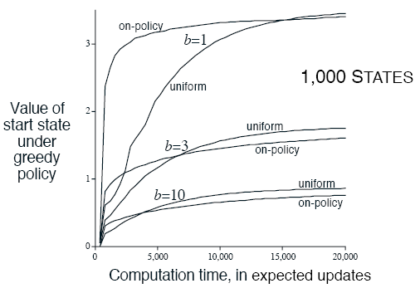
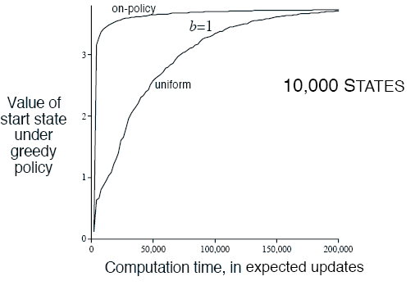
8.6 Trajectory Sampling
Comparing two ways of distributing updates.
1. Classical approach is to sweeps through entire state space.
2. Second is to sample according to some distribution (on-policy distribution).
One simulates explicit individual trajectories and performs updates at the state or state-action pairs encountered along the way → trajectory sampling
대부분의 space를 무시할 수 있어서 이점이 있는 반면,
Same old parts of the space만 계속해서 update하게 될 수 있다는 단점이 있다.
초반에는 가능한 state들에 집중하기 때문에 좋은 성능을 내지만
후반에는 이미 잘 예측된 state을 계산 하는 것은 useless.

Slide 18
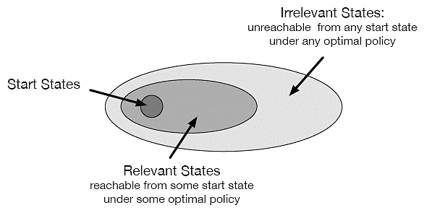
8.7 Real-time Dynamic Programming
RTDP 는 DP의 value-iteration algorithm의 on-policy trajectory-sampling 버전.
(기존 DP의 value-iteration은 sweep based)
주어진 policy로 갈 수 없는 state들은 skip함. → optimal partial policy

Slide 19
8.8 Planning at Decision Time
Planning은 다음 두 가지 방법으로 사용.
Gradually improve a policy or value function
simulated experience 를 이용하여 정책을 개선
Planning is not focused on the current state (background planning)
현재 state의 q값들을 비교하여 a를 선택.
DP, Dyna
Begin and complete it after encountering each new state to decide action.
Simulated experience 를 이용하여 행동 선택
Next state의 Model-predicted value를 비교하여 a를 선택. (select action)
Focuses on a particular state. (decision-time planning)
시간이 충분한 경우에만 사용가능.
Heuristic search, Rollout Algorithm, MCTS

Slide 20
8.9 Heuristic Search
Decision-time planning 의 대표적인 방법
매 state마다 large tree of possible continuation을 고려함.
Leaf 노드에서 v를 추정한 뒤 current state at the root 로 back up.
현재 state의 v 가 계산되면, 최적의 a를 선택하고, 계산 된 v 는 버림.
모델은 완벽한데, action-value function이 불완전 한 경우, deep하게 탐색할 수록 좋은 결과를 내고,
만약 episode 끝까지 탐색하면, 항상 optimal a를 선택할 수 있다.
하지만 computation이 큼.
모든 computation과 메모리 resource를 현재 event에 집중.

Slide 21
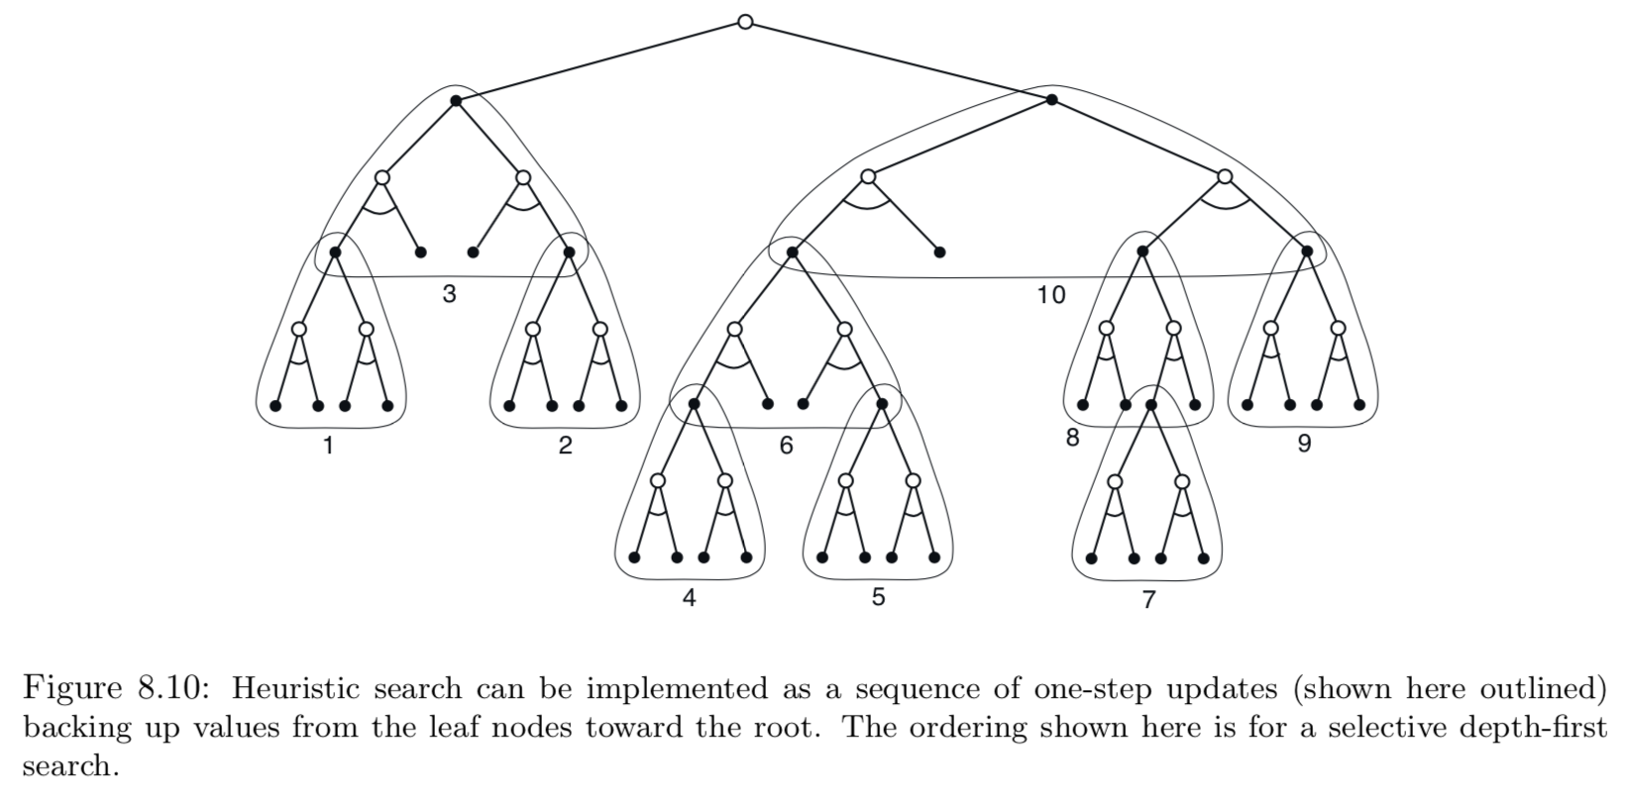
8.9 Heuristic Search
As a limiting case we might use the methods of HS to construct a search tree, and then perform the individual, one-step updates from bottom up.
Deeper search에 의한 성능 개선은 multistep update 때문이아니라, 현재 state에서 downstream state, action update에 집중하기 때문이다.?

Slide 22
8.10 Rollout Algorithms
Simulated trajectories에 Monte Carlo control을 적용한 것을 기반으로 한 Decision-time planning.
여러 trajectories의 return들의 평균으로 q를 계산.
q가 충분히 정확하게 estimate되면, 다음 state에서 다시 시작.
The term ‘rollout’ comes from estimating the value of a backgammon position by playing out the position many times to the game’s end with randomly generated sequences of dice rolls, where the moves of both players are made by some fixed policy.
MC control과는 다르게, rollout은 complete optimal q*나 complete q를 estimate 하려는게 아니라
현재 state와 given policy의 MC estimates of action value를 구하려는것.
마찬가지로 쓰고나서 버림.
This makes rollout algorithm relatively simple to implement because there is no need to sample outcomes for every state-action pair, and there is no need to approximate a function over either the state space or the state-action space.
Rollout algorithm의 목표는 optimal policy 를 찾는게 아니라, improve upon the default policy.

Slide 23
8.11 Monte Carlo Tree Search
MCTS is a recent and strikingly successful example of decision-time planning.
베이스는 rollout algorithm이지만, enhanced by the addition of a means for accumulating value estimates obtained from the MC simulations in order to successively direct simulations toward more highly-rewarding trajectories.
The core idea is to successively focus multiple simulations starting at the current state by extending the initial portions of trajectories that have received high evaluations from earlier simulations.
It does not have to retain approximate value functions or policies from one action selection to the next, though in many implementations it retains selected action values likely to be useful for its next execution.
대부분 simulated trajectory에서 간단한 policy에 의해 행동이 선택된다. 보통 rollout policy라 부름.
Value estimate들은 적은 step안에 도달 할 수 있는 state-action pair에 대해서만 저장된다.

Slide 24
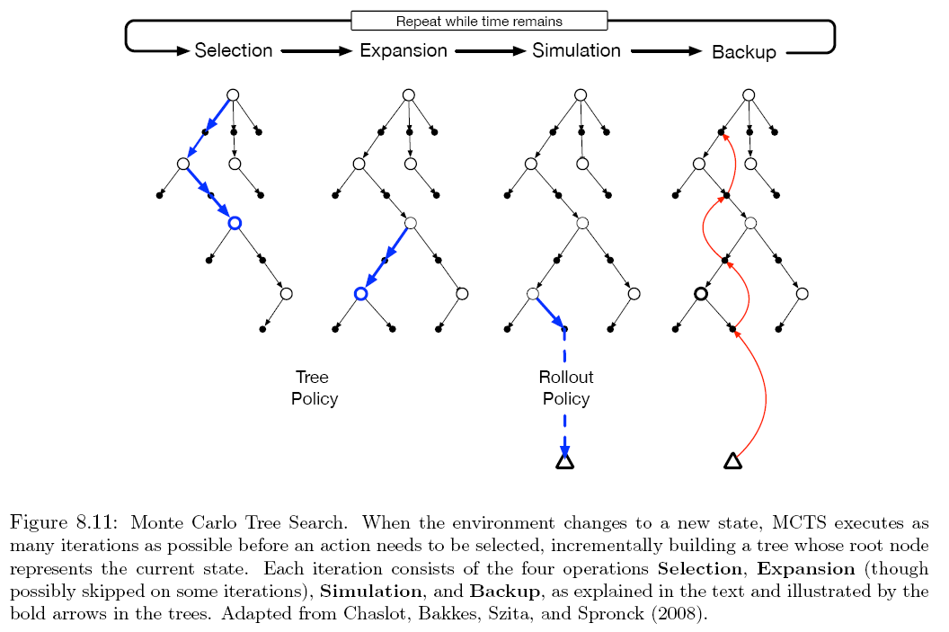
8.11 Monte Carlo Tree Search
Selection. Starting at the root node, a tree policy based on the action values attached to the edges of the tree traverses the tree to select a leaf node.
Expansion. On some iterations, the tree is expanded from the selected leaf node by adding one or more child nodes reached from the selected node via unexplored actions.
Simulation. From the selected node, or from one of its newly-added child node, simulation of a complete episode is run with actions selected by the rollout policy. The result is a MC trial with action selected first by the tree policy and beyond the tree by the rollout policy.
Backup. The return generated by the simulated episode is backed up to update, or to initialize the action values attached to edges. No values are saved for the states and actions visited by the rollout policy beyond the tree.
(e-greedy)

Slide 25
8.11 Monte Carlo Tree Search
루트 노드에서, 주어진 시간이 끝날 때 까지, 혹은 컴퓨팅 자원이 소모될때 까지 같은 과정을 반복한 뒤 a 선택
MCTS avoid the problem of globally approximating an action-value function while it retains the benefits of using past experience to guide exploration
가나다라마

